Slide 1
Boolean Algebra

Slide 2
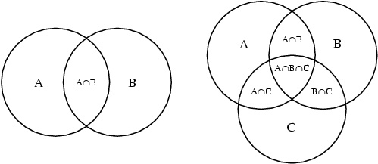
Venn Diagram

Slide 3
Logical Convention
Logic is binary (true or false)
Can be represented by two opposites
Examples: Up Down
Right Left
Forward Backward
Standard convention is:
True = ‘1’ False = ‘0’

Slide 4
Logical AND
Truth Table
A B | X
0 0 0
0 1 0
1 0 0
1 1 1
X = A AND B
Karnaugh - Map
A\B | 0 | 1
0 | 0 | 0
1 | 0 | 1

Slide 5
Logical OR
Truth Table
A B | X
0 0 0
0 1 1
1 0 1
1 1 1
X = A OR B
Karnaugh - Map
A\B | 0 | 1
0 | 0 | 1
1 | 1 | 1

Slide 6
Logical Not
Truth Table
A | X
0 1
1 0
X = !A
Karnaugh - Map
A
0 | 1
1 | 0

Slide 7
Karnaugh Map
(Sum of Products)
K-maps are a graphical representation of a group of adjacent Boolean variables
K-maps graphically help simplify complex logical problems
By grouping the outputs in binary size groups of the largest size 8 – 4 – 2 - 1
Then extract the simplified equations by the products then the sums

Slide 8
Simplify the following
X = !A!B!C!D + !A!B!C + A!B!C
Take each Product (AND’s) and place the true values (1)’s in the K-map
Circle the largest binary groups
Extract the groups with Sums (OR’s)
Now you have the simplest answer in Sum of Product form (SOP)

